Slide 1
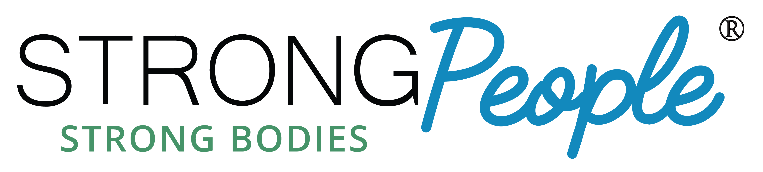
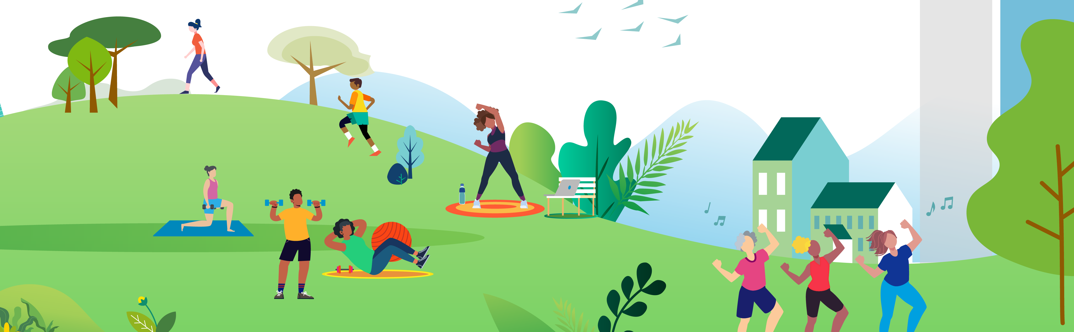
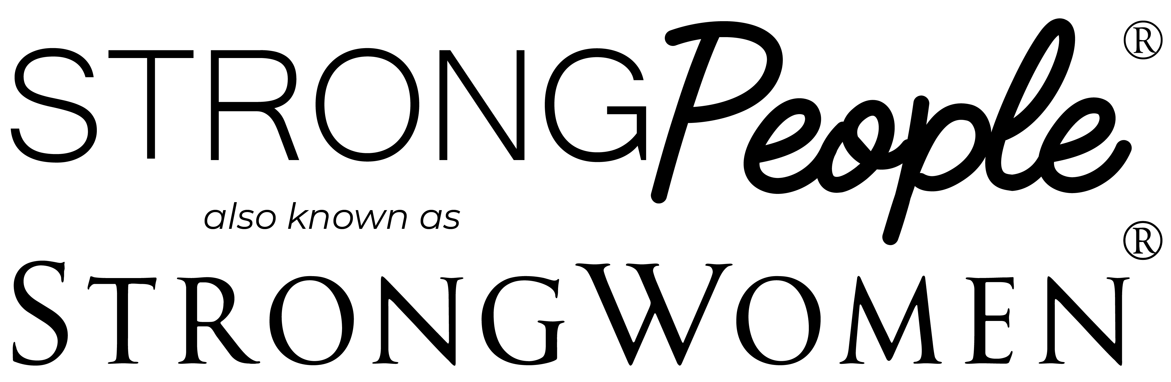
Join us for strength training classes! These
classes are designed for mid-life and older adults
and include progressive resistance training,
balance training, and flexibility exercises.
Classes are twice weekly for 12 weeks, led by
County Extension Agents.
Dates:
Time:
Location:
Contact:

