Slide 1
Home Environment Assessment
Notes:
Home Environment Assessment: “Making the Healthy Choice the Easy Choice”
Revised September 2022

Slide 2
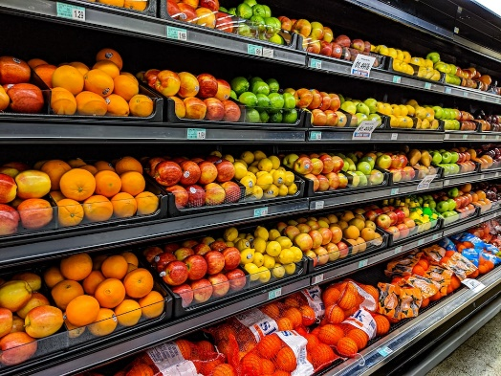
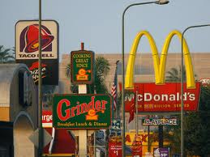
Environmental Influences on Food Choices
Our environment makes a big difference in what we eat.
Less accessibility to grocery stores may be a barrier to buying and eating healthier foods
More access to fast food restaurants may lower the quality of your diet
Dixon BN, Ugwoaba UA, Brockmann AN, Ross KM. Associations between the built environment and dietary intake, physical activity, and obesity: a scoping review of reviews. Obes Rev. 2021 Apr;22(4):e13171. doi: 10.1111/obr.13171.
Notes:
[Images throughout are from unsplash and the previous version of this presentation.]

Slide 3
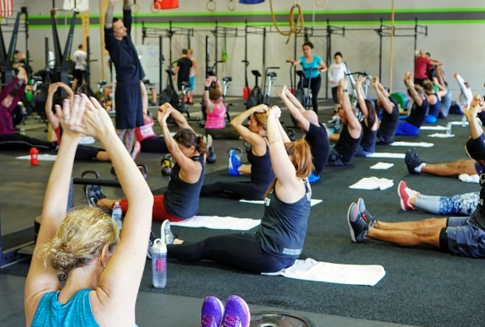
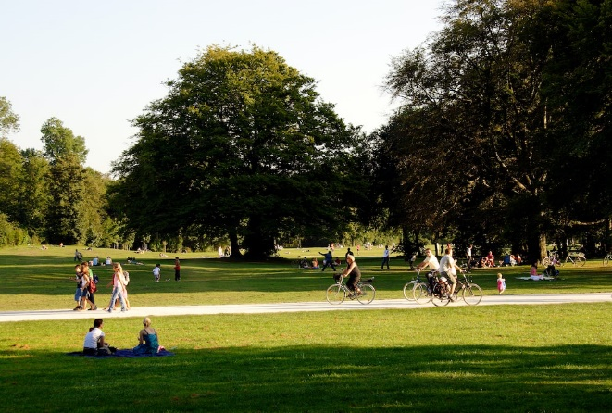
Environmental Influences on Physical Activity
Our environment makes a big difference in how active we are.
Having recreational facilities (e.g., gyms) nearby may promote more physical activity
Having parks/trails nearby may promote more physical activity
Dixon BN, Ugwoaba UA, Brockmann AN, Ross KM. Associations between the built environment and dietary intake, physical activity, and obesity: a scoping review of reviews. Obes Rev. 2021 Apr;22(4):e13171. doi: 10.1111/obr.13171.

Slide 4
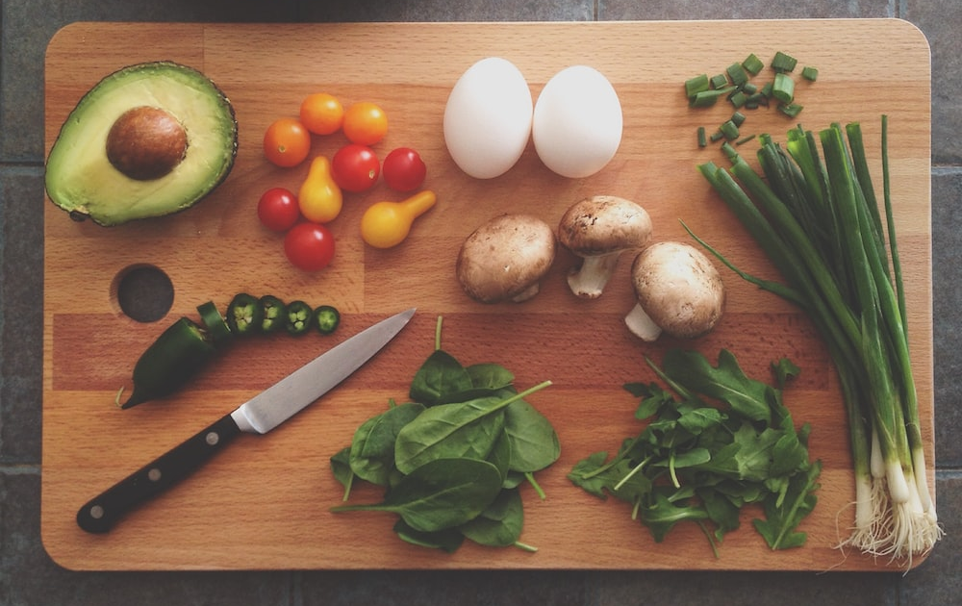
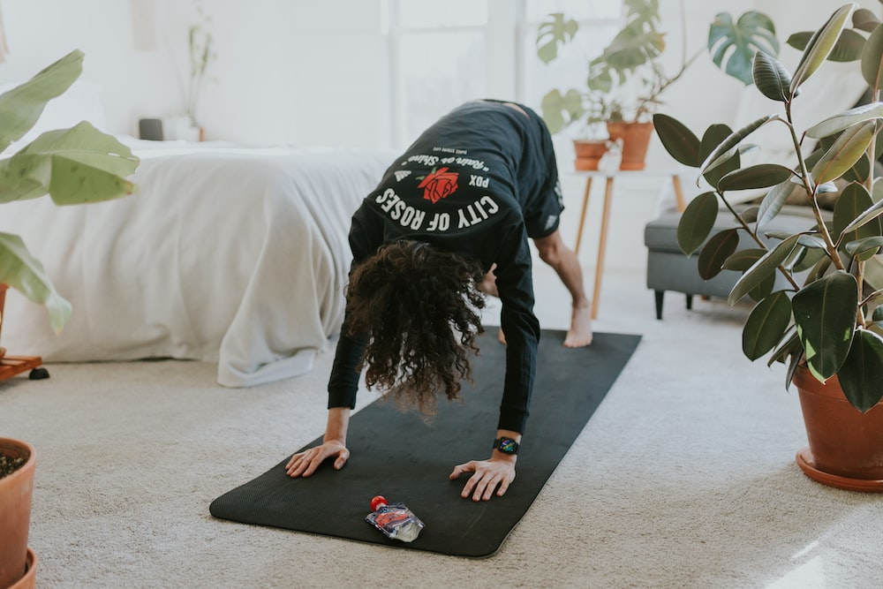
However, you can try remodeling your home environment
To improve what and how much you eat
To increase your activity level
and

Slide 5
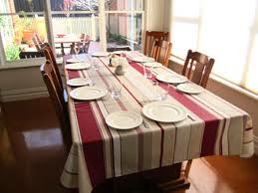
Easy Remodeling for Eating Better
What’s on the Counter Counts
Refrigerator Review
Cupboards as Cover-alls
Healthy Inventory

Slide 6
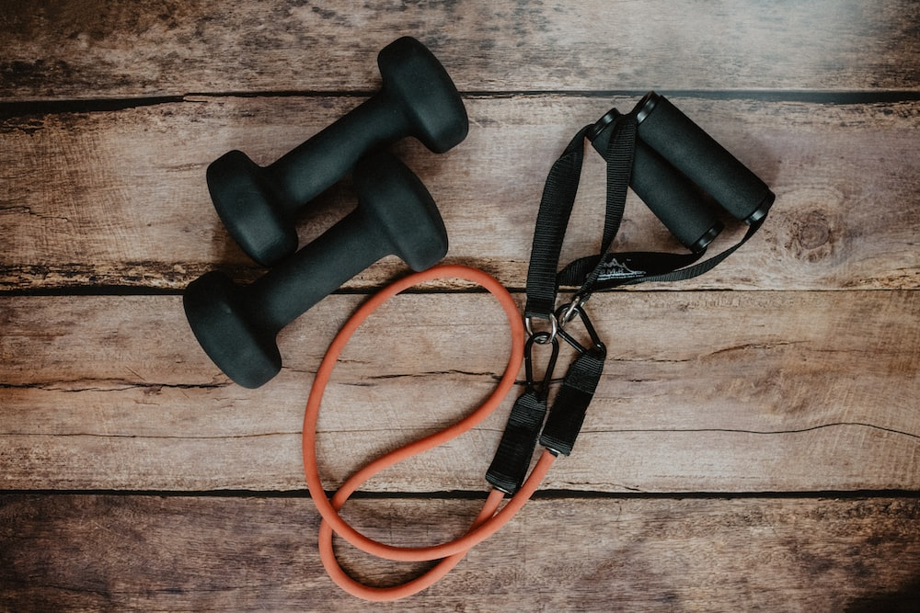

Easy Remodeling for More Activity
Clothes and Equipment
Healthy Inventory

Slide 7


What the Research Shows
Keeping FEWER unhealthy snacks and placing them FARTHER away from you can reduce how much you eat them.
Placing healthier snacks CLOSER can make you more likely to choose them.
Let’s put that into practice in our own homes!
Hollands GJ, Carter P, Anwer S, King SE, Jebb SA, Ogilvie D, Shemilt I, Higgins JPT, Marteau TM. Altering the availability or proximity of food, alcohol, and tobacco products to change their selection and consumption. Cochrane Database Syst Rev. 2019 Sep 4;9(9):CD012573. doi: 10.1002/14651858.CD012573.pub3.
van Kleef E, Otten K, van Trijp HC. Healthy snacks at the checkout counter: a lab and field study on the impact of shelf arrangement and assortment structure on consumer choices. BMC Public Health. 2012 Dec 12;12:1072. doi: 10.1186/1471-2458-12-1072.

Slide 8
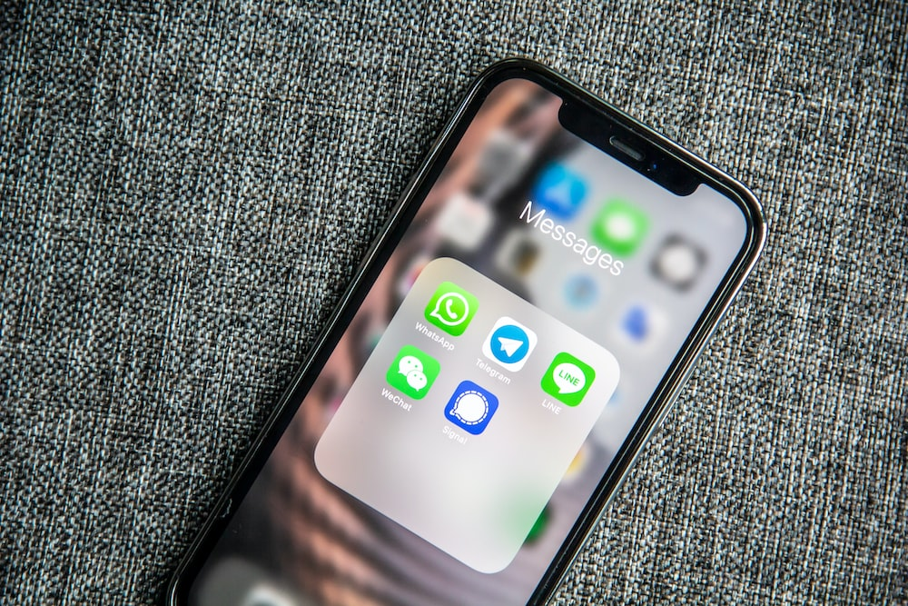
What the Research Shows
Visual cues, or prompts (such as a text reminder) can remind you to perform certain behaviors if you already have a goal in mind to do that behavior.
Let’s put that into practice in our own homes!
Pirolli P, Mohan S, Venkatakrishnan A, Nelson L, Silva M, Springer A. Implementation intention and reminder effects on behavior change in a mobile health system: a predictive cognitive model. J Med Internet Res. 2017 Nov 30;19(11):e397. doi: 10.2196/jmir.8217.

Slide 9
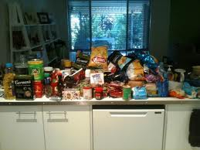
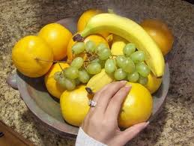
What’s on the Counter Counts
Try keeping unhealthy snacks away from the counter and healthier snacks on the counter
Before
After

Slide 10
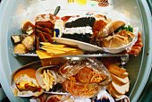
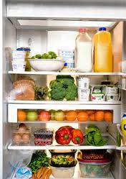
Refrigerator Review
Try putting healthier foods in visible and easy-to-grab locations in your refrigerator, such as the front of the top shelf.
Before
After

Slide 11
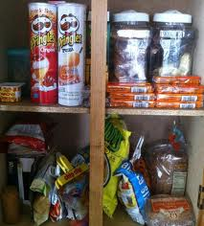

Cupboards as Cover-alls
Try keeping unhealthy foods farther away and in hard-to-reach places such as in your cupboards.
Before
After

Slide 12
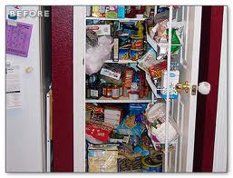
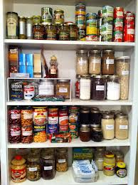
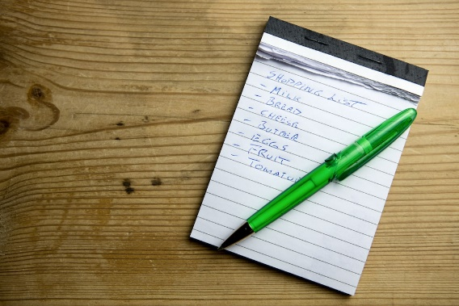
Healthy Food Inventory
Trying keeping FEWER unhealthy foods and MORE healthy foods in your pantry and refrigerator to encourage selection of healthier options.
Make a shopping list of healthy foods to stock to remind you of what to buy.
Before
After

Slide 13
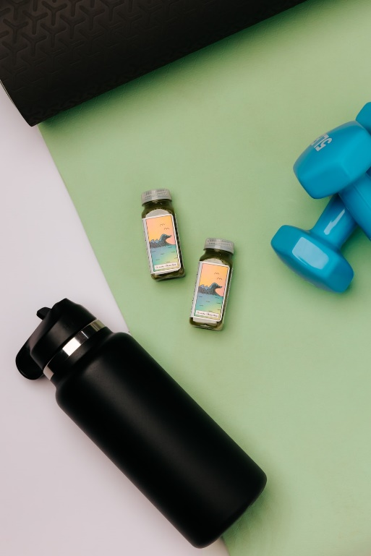
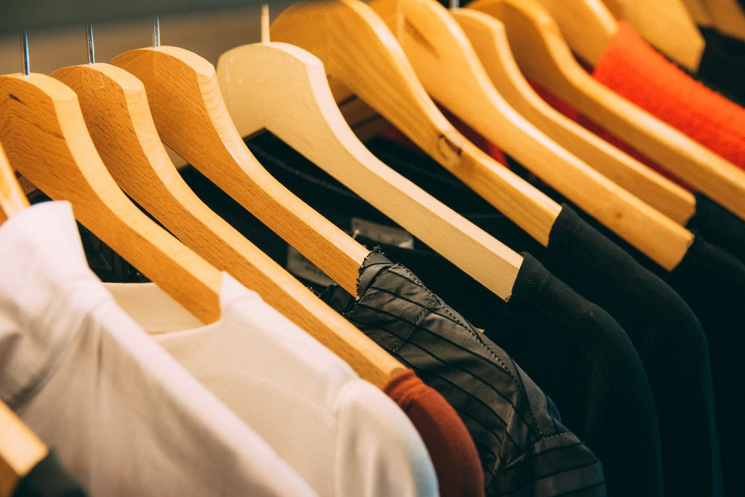
Clothes and Equipment
Try to keep your active clothing and equipment in a visible place in your home for a visual reminder

Slide 14
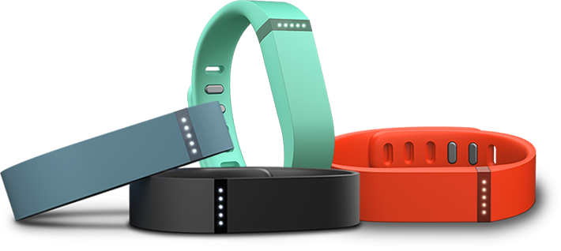
Healthy Physical Activity Inventory
Try keeping MORE physical activity clothing, equipment, and resources to keep readily available in your home, such as:
Clothing appropriate for activity.
Good walking shoes.
Exercise equipment such as weights, exercise ball, exercise videos or streaming, and a dog leash.
Recreational equipment such as golf clubs and swimming suit.
List of active people to call.
Activity classes schedule or list of nearby gyms, parks, trails, etc.
Physical activity monitor.

