Slide 1
Portion Distortion Interactive Quiz
Notes:
The Portion Distortion Interactive Quiz helps participants understand portion sizes based on the Daily Food Plan.
Information on food composition, portion and serving sizes is from the USDA’s FoodData Central, NIH Portion distortion quiz, and StrongPeople Health Journal
https://fdc.nal.usda.gov/
https://www.nhlbi.nih.gov/health/educational/wecan/eat-right/portion-distortion.htm

Slide 2
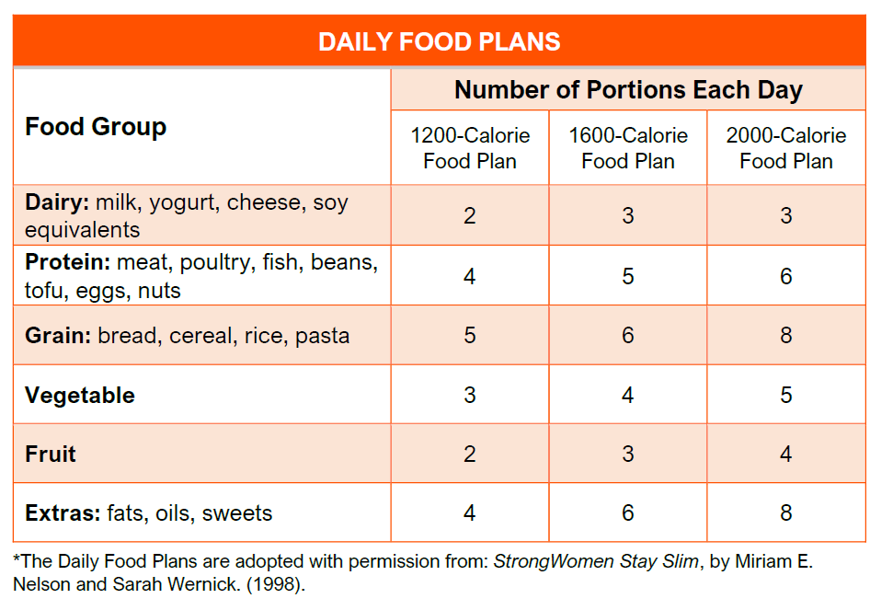
Daily Food Plan Review

Slide 3
Food Groups

Slide 4
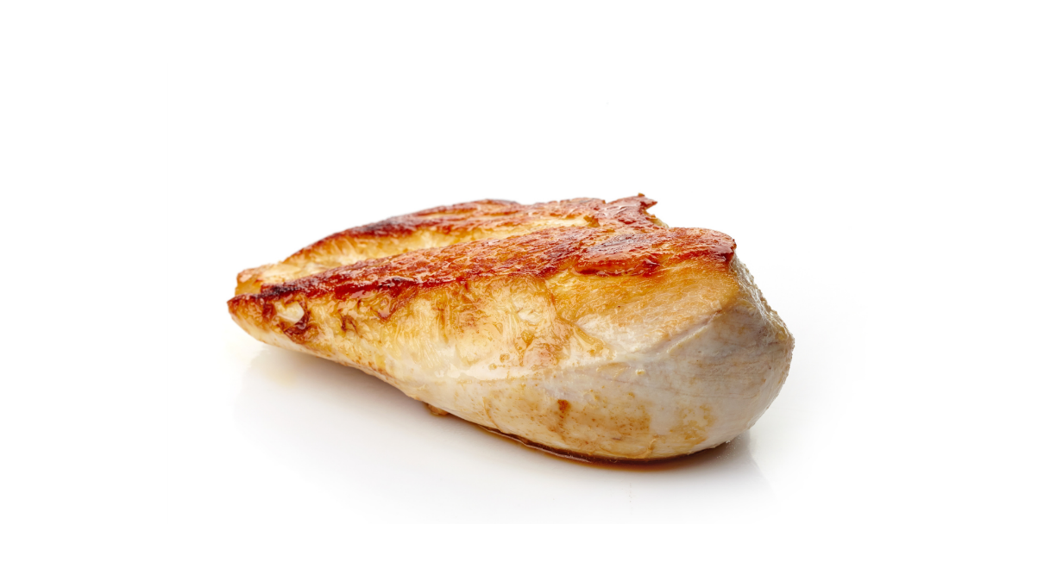
Protein
Typical Serving of Chicken Breast
Based on the Daily Food Plan, how many portions is this?
4 oz

Slide 5
Protein
Typical Serving of Chicken Breast
Based on the Daily Food Plan, how many portions is this?
4 oz
4 portions

Slide 6
Fruit
Typical Serving of Berries
Based on the Daily Food Plan, how many portions is this?
½ cup of berries

Slide 7
Fruit
Typical Serving of Berries
Based on the Daily Food Plan, how many portions is this?
½ cup of berries
1 portion

Slide 8
Vegetables
Typical Serving of Cooked Broccoli
Based on the Daily Food Plan, how many portions is this?
½ cup of cooked broccoli

Slide 9
Vegetables
Typical Serving of Cooked Broccoli
Based on the Daily Food Plan, how many portions is this?
½ cup of cooked broccoli
1 portion

Slide 10
Grains
Typical Serving of Cooked Rice
Based on the Daily Food Plan, how many portions is this?
1 cup of cooked rice

Slide 11
Grains
Typical Serving of Cooked Rice
Based on the Daily Food Plan, how many portions is this?
1 cup of cooked rice
2 portions

Slide 12
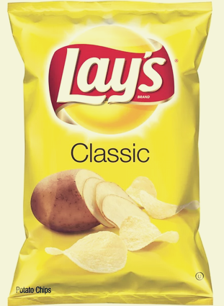
Extras
Potato chips
Based on the Daily Food Plan, how many portions is this?
160 calories
28 grams

Slide 13
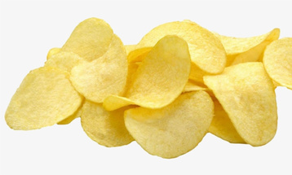
Extras
Potato chips
Based on the Daily Food Plan, how many portions is this?
2 portions
160 calories
28 grams

Slide 14
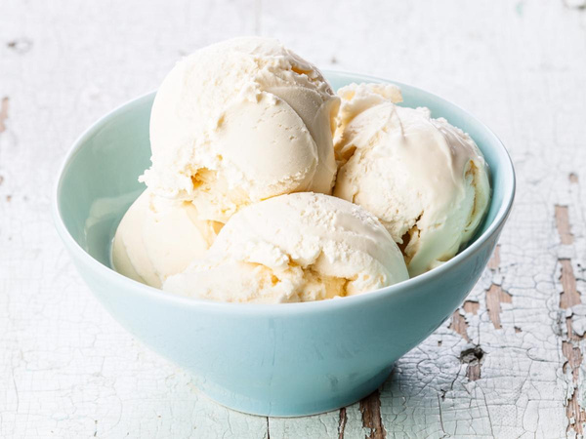
Extras
Typical Serving of Ice Cream (Regular)
Based on the Daily Food Plan, how many portions is this?
8 ounces (1 cup)

Slide 15
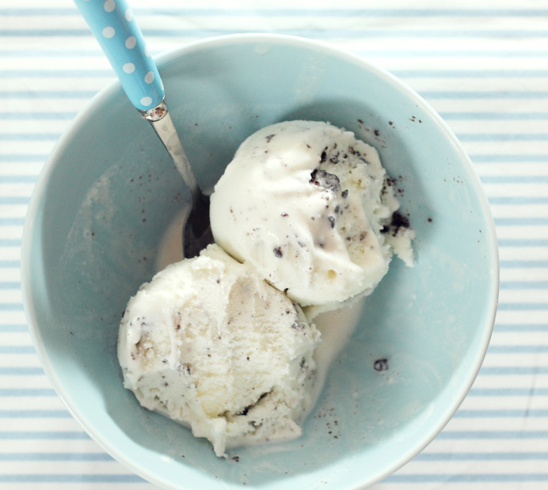
Extras
Typical Serving of Ice Cream (Regular)
Based on the Daily Food Plan, how many portions is this?
8 ounces (1 cup)
2 portions

Slide 16
Extras
Popcorn, air popped
Based on the Daily Food Plan, how many portions is this?
11 cups

Slide 17
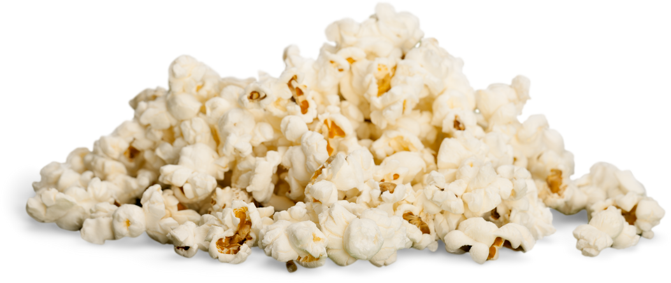
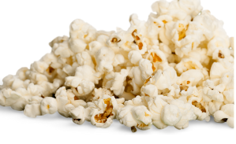
Extras
Popcorn, air popped
Based on the Daily Food Plan, how many portions is this?
11 cups
5½ Portions

Slide 18
Next-to-Nothing
Black Coffee
(no additions)
Based on the Daily Food Plan, how many portions is this?

Slide 19
Next-to-Nothing
Black Coffee
(no additions)
Based on the Daily Food Plan, how many portions is this?
This does not count as a portion, as it is under the “Next-to-Nothing” category

Slide 20
Food Combinations

Slide 21
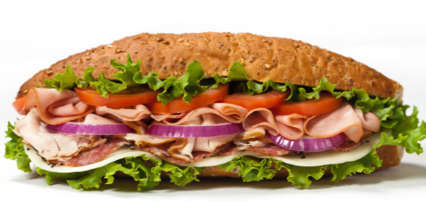
Subway Cold Cut Combo
6” Sandwich
Based on the Daily Food Plan, how many portions is this?

Slide 22
Subway Cold Cut Combo
6” Sandwich
Based on the Daily Food Plan, how many portions is this?
Food Group | Items | Portions | +Extras
Protein | Deli meat, 2 oz | 2 | 1
Grain | Multigrain bread | 2 | -
Dairy | American cheese, 1 slice | 1 | 1
Next-to-Nothing | Lettuce | - | -
 | Tomato | - | -
 | Cucumber | - | -
 | Onion | - | -
 | Green Pepper | - | -
Extras | Mayonnaise, 3 tsp | - | 3
Total Portions + Extras |  | 2 Protein 2 Grain 1 Dairy | 5 Extras

Slide 23
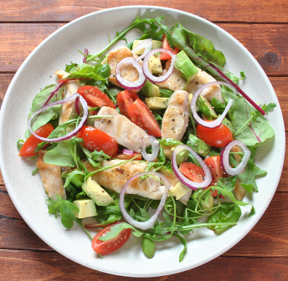
Panera Fuji Apple Salad w/ Chicken + Side of Baguette
Based on the Daily Food Plan, how many portions is this?

Slide 24
Panera Fuji Apple Salad w/ Chicken + Side of Baguette
Based on the Daily Food Plan, how many portions is this?
Food Group | Items | Portions | +Extras
Protein | Chicken breast, 1 oz | 1 | -
 | Pecans, 1 oz | 1 | 1
Grain | Baguette, 1 piece | 1 | -
Dairy | Gorgonzola cheese, 1 oz | 1 | 1
Vegetable | Mixed Greens, 2 cups | 1 | -
 | Tomatoes, ½ cup | 1 | -
Fruit | Dried apple chips, ¼ cup | 1 | -
Next-to-Nothing | Onion | - | -
Extras | Apple vinaigrette, 4 tsp | - | 2
Total Portions + Extras |  | 2 Protein 1 Grain 1 Dairy 2 Veg 1 Fruit | 4 Extras

Slide 25
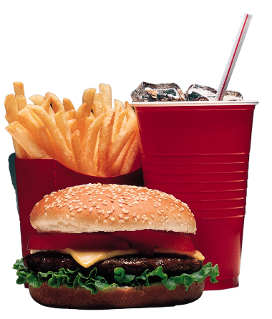
McDonalds Quarter Pounder w/ Cheese Meal
(Large Combo)
Based on the Daily Food Plan, how many portions is this?

Slide 26
McDonalds Quarter Pounder w/ Cheese Meal
(Large Combo)
Based on the Daily Food Plan, how many portions is this?
Food Group | Items | Portions | +Extras
Protein | Beef patty, 4 oz | 4 | 2
Grain | Bun | 2 | -
Dairy | American cheese, 1 oz | 1 | 1
Vegetable | Large fries* | 6 | 3
Next-to-Nothing | Onion Ketchup Mustard Pickle | - | -
Extras | Coca-Cola, 30 fl oz | - | 5
Total Portions + Extras |  | 4 Protein 2 Grain 1 Dairy 6 Veg | 11 Extras

Slide 27
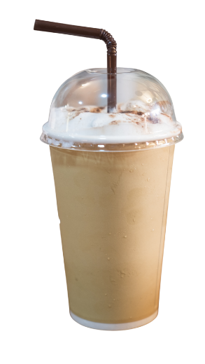
Starbucks Caramel Frappuccino
Based on the Daily Food Plan, how many portions is this?

Slide 28
Starbucks Caramel Frappuccino
Based on the Daily Food Plan, how many portions is this?
Food Group | Items | Portions | +Extras
Protein | - | - | -
Grain | - | - | -
Dairy | Whole Milk | 1 | 2
Vegetable | - | - | -
Next-to-Nothing | Coffee | - | -
Extras | Espresso flavor (3 pumps) Caramel syrup (3 pumps) Whipped cream Caramel Drizzle | - | 3 3 1 2
Total Portions + Extras |  | 1 Dairy | 11 Extras

Slide 29
Portion Size Information
The serving sizes of most foods sold for immediate consumption may exceed the recommended portion sizes.
Larger servings are now offered all around us, including in:
Restaurants
Vending machines
Packaged food in grocery stores
Our perception of what a serving size is has been altered by the increasing availability and marketing of larger food servings.
It’s much better to keep portion sizes under control!
Choose to eat only an appropriate portion size rather than the whole serving given.

Slide 30
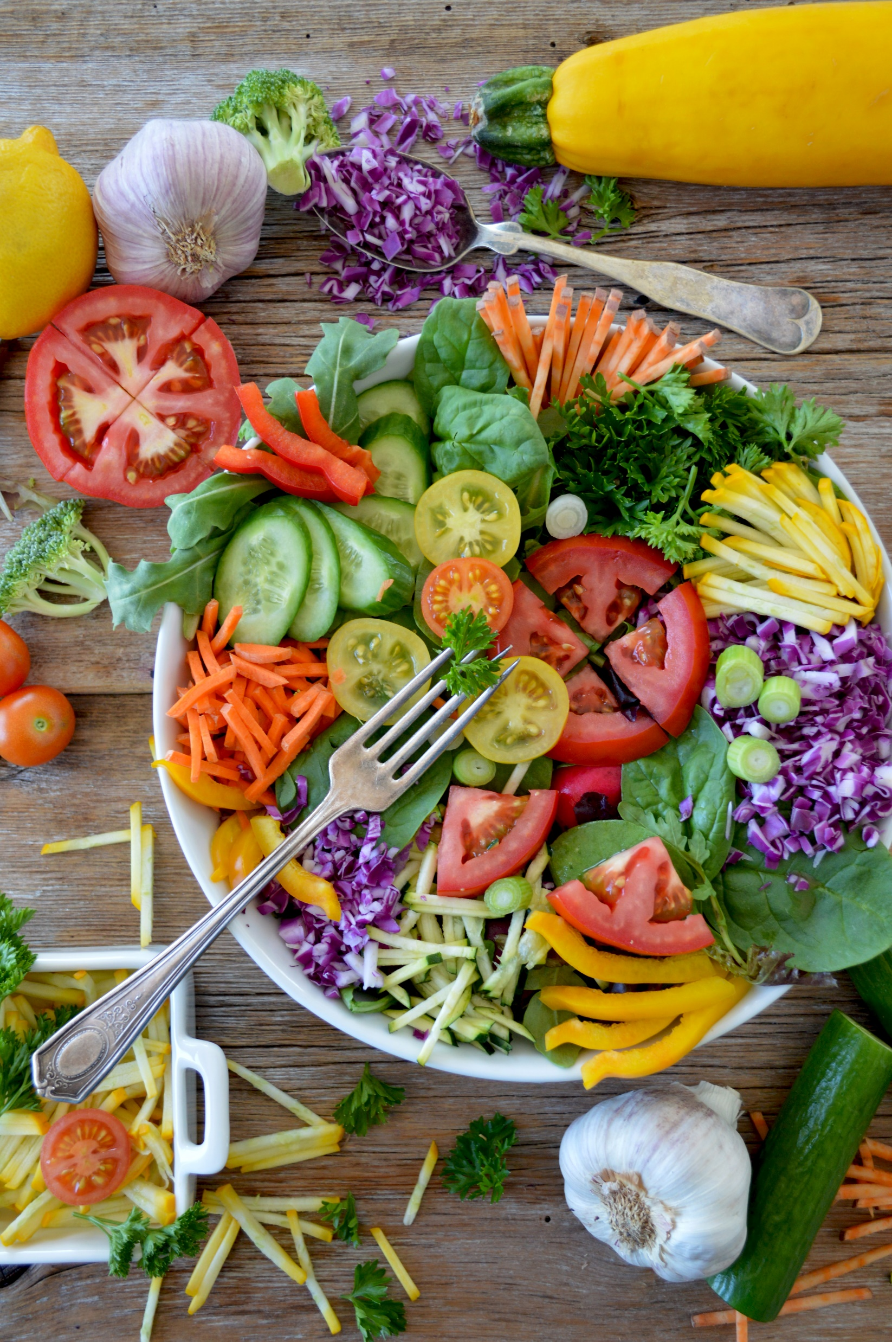
Thank you for participating in the Portion Distortion Interactive Quiz!
© 2022 Rebecca Seguin-Fowler and the StrongWomenTM/StrongPeopleTM Program. All rights reserved.

